Slide 1
Study Trip
Teodor Rosioru
Razvan Roman
Iulia Verdes
Petrica Purghel

Slide 2
General overview-agenda
An application where students can log in to a platform to find courses from various fields to help them discover their passion and understand what job might suit them in the future.
Another benefit of the application would be for companies as it helps employers find their perfect candidates.

Slide 3
Business Perspective
Statement
Lack of job market knowledge and false expectations
Numerous college students lack adequate preparation for actual employment, while many companies hold misconceptions about prospective job applicants.
Audience
Both students and companies
Individuals aspiring to enhance their skills for improved job prospects, and companies seeking to ensure students acquire the necessary skills for their needs.
Solution
An online course platform
Companies have tailored these courses to ensure that students attain the anticipated skills, providing them with a chance to explore their passions within a more realistic simulated work setting.

Slide 4
Technical Perspective
React.js,CSS styling
and Material UI
Spring Boot, Spring Security, MySql Database
RestfulAPIs,Email integraition(SMTP Servers)
Cloud Hosting, integrate conference APIs,AI/ML algorithms for quizes
Docker support,JUnit testing,Git version control

Slide 5
Wireframe
Login/Register
Custom Feed Page
Companies Page
Courses Page
Enroll Page

Slide 6
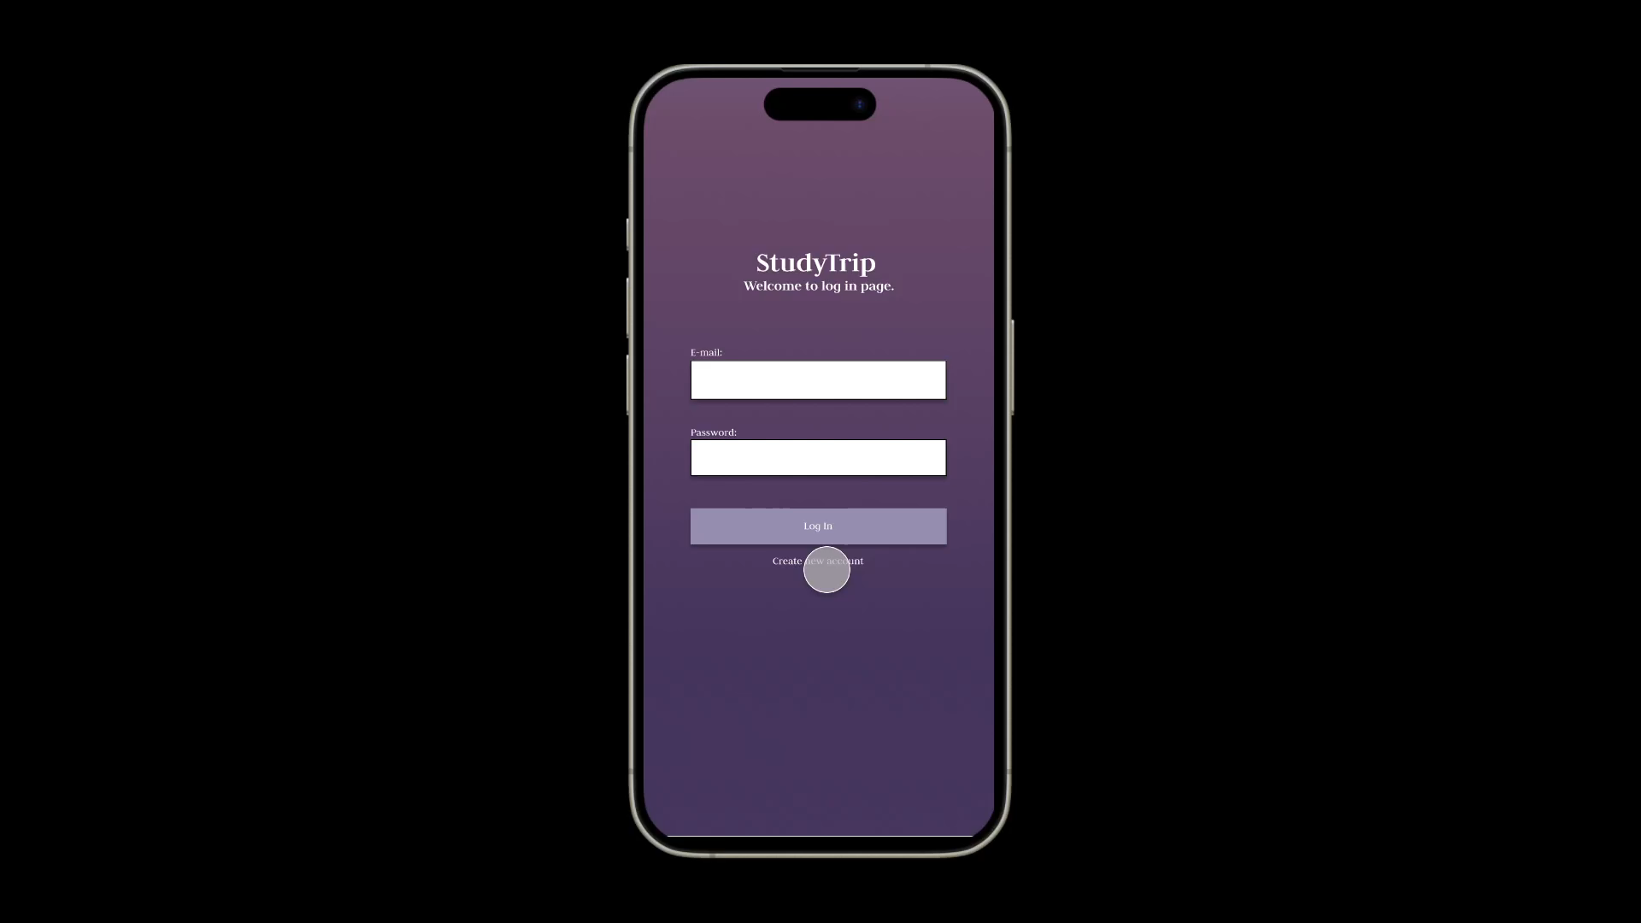
Demo

